Slide 1
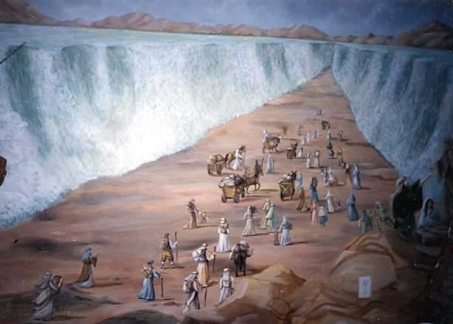
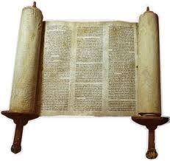
Hebrew (עברית, Ivrit)
A Language in 10 Minutes
Wael Salloum
Abdullah Al-Syed

Slide 2
Language Profile
Belongs to the Semitic Languages Family
  Arabic and Aramaic are close relatives
Spoken by around 5.3 million people
  5.2 million first language speakers in Israel
  > 200,000 Americans speak Hebrew at home (US Census 2007)
Official language of Israel
The liturgical language of Judaism
Revived as a spoken language in the 19th and 20th centuries

Slide 3
Hebrew Script
Written right to left
No capital letters
22 letters in the aleph bet, two of which are used as vowels as well as consonants ( )
Vowels indicated by dots and dashes above and below letters (nikkud), usually omitted in modern writing.
י
ו

Slide 4
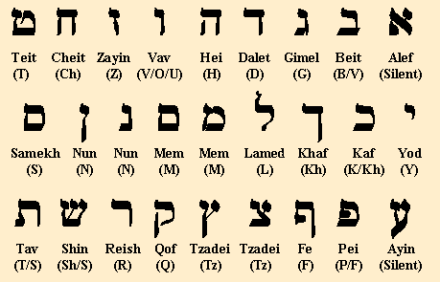

Hebrew Aleph bet

Slide 5
Orthographic Ambiguity
ת
ש
ר
ק
צ
פ
ע
ס
נ
מ
ל
כ
י
ט
ח
ז
ו
ה
ד
ג
ב
א
ʃ
r
ts
p
f
s
n
m
l
k
j
e
i
t
x
z
o
u
h
d
g
v
b
a
Courtesy N. Habash

Slide 6
Hebrew Morphology
A Hebrew root consists of three consonants
Only takes on a meaning when combined with a pattern, e.g. root q-l-t appears in the following words:
  qalat – to take in
  miqlat – refuge
  qelet – input
The above words all have something to do with “taking in” or “being taken in”.

Slide 7
Morphological Ambiguity
High morphological ambiguity in Hebrew is a challenge for MT from Hebrew to other languages.
  E.g. B$WRH has four possible analyses, shown in lattice representation:
    Noun “B$WRH” (gospel)
    Noun “$WRH” (line) preceded by preposition “B” (in)
    Noun “$WRH” (line) preceded by preposition “B” (in) and a hidden definite article “H” (the)
    Noun “$WR” (bull) preceded by preposition “B” (in) and followed by attached pronominal possessive clitic “H” (her)
B$WRH (gospel)
B (in) |  | $WRH (line)
B (in) | H (the) | $WRH (line)
B (in) | $WR (bull) |  | H (her)

Slide 8
Hebrew Syntax
Word order is rather free in Hebrew:
  Memshalah Chadashah Kamah (mehm-shah-lah chah-dah-shah kah-mah; Literally: government new arises)
  Kamah Memshalah Chadashah (kah-mah mehm-shah-lah chah-dah-shah; Literally: arises government new).
Hebrew has only the definite article, "ha-“, no indefinite article
Two genders: masculine and feminine, no neuter
Plural suffix –im for masc nouns, -ot for fem nouns

Slide 9
Hebrew Syntax (contd.)
To negate, insert lo before word being negated, e.g. lo, ani lo professor = No, I am not a professor.
Adjectives follow nouns they describe, agree in gender and number
  A good evening -> erev tov
  A good address -> ktovet tovah
  Good films -> sratim tovim
Conjunctions that join statements to form sentences appear as prefixes, not separate words, e.g. v’ (and), she’ (that) → possible ambiguity
The word Et (eht) precedes the definite direct object
  Mollie Nishkah Et Fred (moh-lee neesh-kah eht fred; Literally: Mollie kissed Fred)

Slide 10
Hebrew Computational Efforts
Hebrew resources
Hebrew to English
Hebrew to Spanish
Hebrew to Russian
Hebrew to Arabic
Google’s pivoting through English

Slide 11
Hebrew Resources
http://www.mila.cs.technion.ac.il/english/resources/index.html
Hebrew Corpora List
      Forums Corpora
      TheMarker Corpora
      Hebrew Dotted Corpora
      Haknesset Hebrew Corpora
      Arutz 7 corpus
      Haaretz Corpus
      Tel Aviv Spoken Hebrew corpus
Hebrew Annotated Corpora List
      Hebrew Treebank Project

Slide 12
Hebrew Resources
Software
  Hebrew HMM Tagger
  Morphological Analyzer SOAP Web Service
Standards
  Hebrew Corpus Schema
  Hebrew Lexicon Schema

Slide 13
Thank you

Slide 14
References
Hebrew
(2003) Alon Itai & Erel Segal: A corpus based morphological analyzer for unvocalized modern Hebrew. MT Summit IX -- workshop: Machine translation for semitic languages, New Orleans, USA, 23 September 2003 [PDF, 250KB]
(2003) Shuly Wintner & Shlomo Yona: Resources for processing Israeli Hebrew. MT Summit IX -- workshop: Machine translation for semitic languages, New Orleans, USA, 23 September 2003 [PDF, 56KB]
Hebrew to English
(2010) Yulia Tsvetkov & Shuly Wintner: Automatic acquisition of parallel corpora from websites with dynamic content. LREC 2010: proceedings of the seventh international conference on Language Resources and Evaluation, 17-23 May 2010, Valletta, Malta; pp.3389-3392. [PDF, 447KB]
(2004) Alon Lavie, Erik Peterson, Katharina Probst, Shuly Wintner & Yaniv Eytani: Rapid prototyping of a transfer-based Hebrew-to-English machine translation system; TMI-2004: proceedings of the Tenth Conference on Theoretical and Methodological Issues in Machine Translation, October 4-6, 2004, Baltimore, Maryland, USA; pp.1-10 [PDF, 158KB]
(2000) Uzzi Ornan & Israel Gutter: Machine translation by semantic features. MT2000: machine translation and multilingual applications in the new millennium: international conference at the University of Exeter, 20-22 November 2000, organised by the British Computer Society. [London: BCS]; 8pp. [PDF, 1471KB]
Hebrew to Arabic
(2010) Reshef Shilon, Nizar Habash, Alon Lavie and Shuly Wintner: MACHINE TRANSLATION BETWEEN HEBREW AND ARABIC: NEEDS, CHALLENGES AND PRELIMINARY SOLUTIONS, AMTA

Slide 15
References
Hebrew to Spanish
(2000) Uzzi Ornan & Israel Gutter: Machine translation by semantic features. MT2000: machine translation and multilingual applications in the new millennium: international conference at the University of Exeter, 20-22 November 2000, organised by the British Computer Society. [London: BCS]; 8pp. [PDF, 1471KB]
Hebrew to Russian
(1998) Guy Bashkansky & Uzzi Ornan: Monolingual translator workstation. Machine translation and the information soup: third conference of the Association for Machine Translation in the Americas, AMTA '98, Langhorne, PA,USA, October 1998; ed. David Farwell, Laurie Gerber, Eduard Hovy (Berlin: Springer Verlag, 1998); pp.136-149. [go to publisher details]

